Slide 1

Water and Air
Khalid Al Manthri 10-A

Slide 2
Water

Slide 3
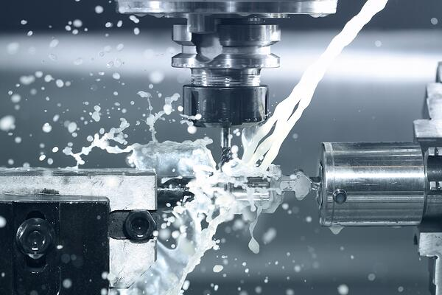

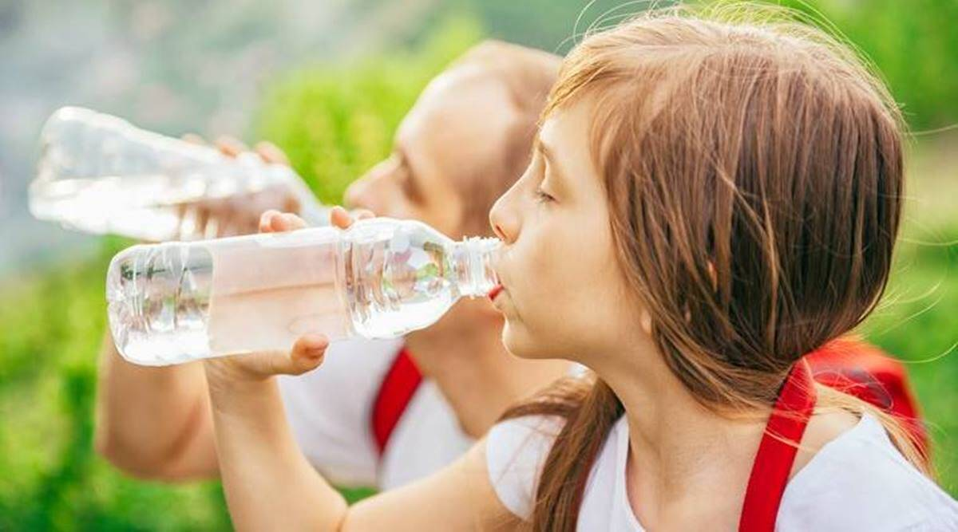
How is water used in industries and houses?
In industries water is used for fabricating. Water can also be used to dilute liquids and cooling. Water in industries can be used to produce different types of food and materials like paper or making chemicals. In homes water is used for washing, drinking, bathing and other daily actions.

Slide 4
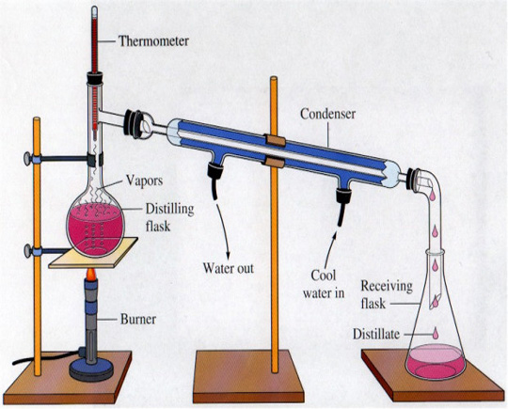
How can dirty water be cleaned?
Dirty water can be cleaned in different ways. Filtration can clean non-dissolved solid particles which separates the solid and the water by letting the water go through the filter and keeping the solid. Distillation can separate dissolved solids from water to clean it. When the water is boiled and the solid has a different boiling point, the solid
will not evaporate. The water vapor is then
separated and condensed (gas to liquid) thus
separating the water and the dissolved mixture.

Slide 5
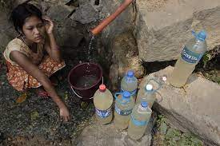
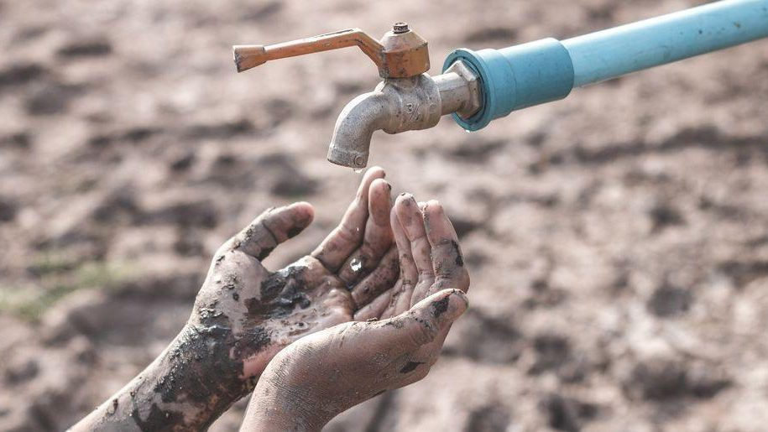
What are the problems of a water shortage?
Water shortage can and will affect a lot of people since most daily actions that use water cannot be done when there is a water shortage. People will have less water to drink, clean and water the plants. That can affect people and spoil the food from the plants. And if industries can't get access to enough water, they cannot provide enough materials or food.

Slide 6
Air

Slide 7
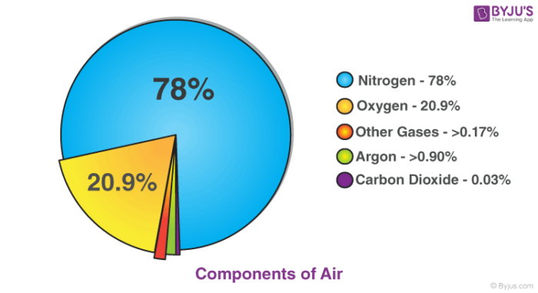
Why do we describe air as a mixture?
Air is described as a mixture because it is made up of different elements and can be separated unlike a compound.

Slide 8
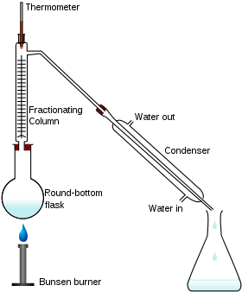
How can we separate the gases in air?
Air can be separated by fractional distillation. Air is vaporized and each gas in the mixture is separated using the advantage that each gas has a different boiling points.

Slide 9
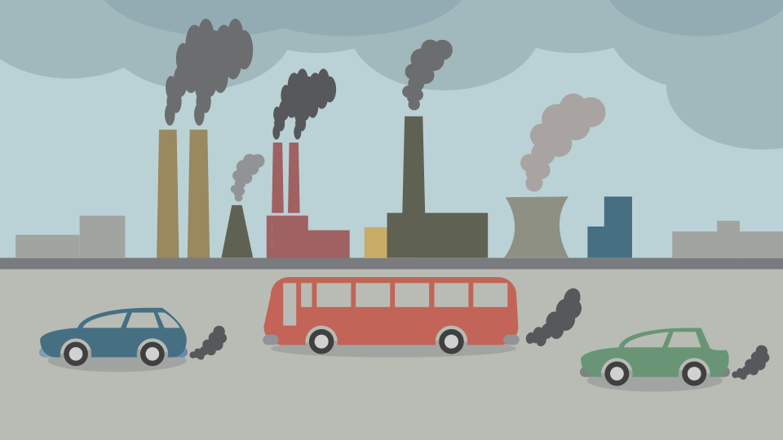
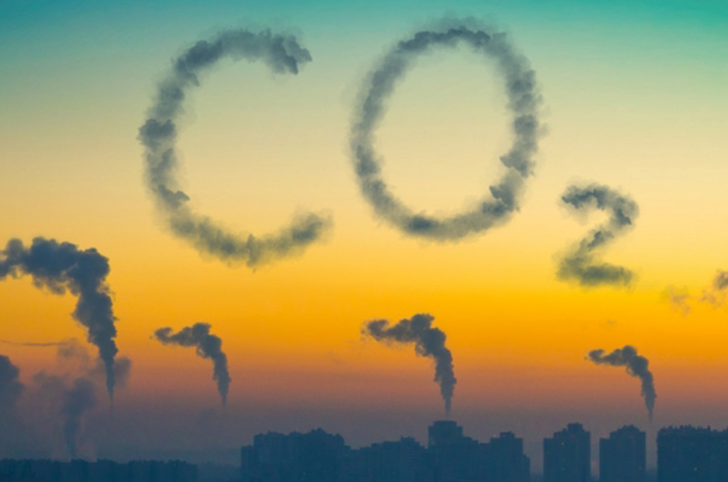
What are the major causes of air pollution?
The major causes of air pollution comes from gases that are dumped into the atmosphere. Some ways the dangerous gases come from is by wildfires that release carbon dioxide which is poisonous for the environment. Wildfires also burn oxygen from the atmosphere. Other causes of major air pollution are vehicles that use gasoline
because it produces carbon dioxide.
The same effects happen when
volcanoes erupt, and
factories emitting the
same dangerous gasses.

Slide 10
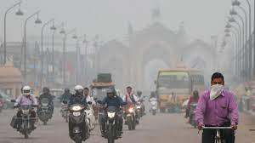
How can these air pollutants affect you locally and globally?
Air pollution can cause to very bad health issues because if these gases are inhaled by anyone it damages their body, this can cause many deaths. Air pollution can also affect plant growth because of the gases. It can affect the food humans eat.

Slide 11

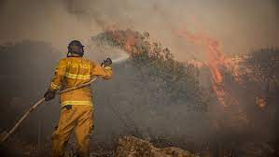
How can we prevent some pollutants from reaching the air?
Using electric cars instead of cars that use gasoline is better for the environment because they don’t produce harmful gases. Reducing the usage of devices that produce harmful gases can help reduce the air pollution. Wildfires can be stopped if more people are careful to extinguish the fires, and sometimes wildfires start because of humans so being careful helps.

Slide 12
Water and Air (rusting)

Slide 13
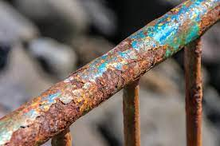
What causes rusting?
Rusting is caused when iron (Fe) particles are exposed to oxygen (O) or moisture.

Slide 14

Chemical reaction of rusting:
Iron and oxygen (rust)
Iron
oxygen

Slide 15
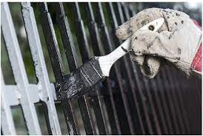
How can we prevent rusting?
We can prevent rusting by preventing iron to be touched by moisture or oxygen, some ways to do that is coating the iron with oil or paint.

Slide 16



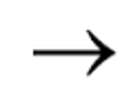
This is how coating iron prevents rusting:
coating iron
coating iron
oxygen
The coating prevents air and moisture from reacting or interacting with the iron because it stops it.

Slide 17
Recourses
https://www.cdc.gov/healthywater/other/industrial/index.html
http://www.planet-science.com/categories/experiments/chemistry-chaos/2012/07/can-you-clean-water.aspx
https://www.vedantu.com/question-answer/air-considered-as-a-mixture-class-9-chemistry-cbse-5f5c41fc8f2fe249180431ba
https://ncerthelp.com/text.php?contype=Concept&class_id=9&sub_id=S&chapter_id=CH2&q_no=15
https://climatekids.nasa.gov/air-pollution/#:~:text=The%20Short%20Answer%3A,our%20air%20are%20called%20aerosols.
https://www.cslsilicones.com/en/about/blog/item/what-causes-corrosion.html
https://www.worldofchemicals.com/605/chemistry-articles/distillation-process-of-chemicals.html
https://byjus.com/chemistry/components-of-air/

